Slide 1
Weekly Progress
Week 8 & 9

Slide 2
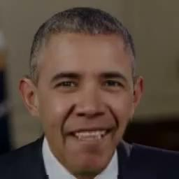
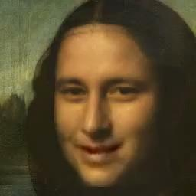

Last year result
Obama - Happy Monalisa - Happy Mark - Happy

Slide 3
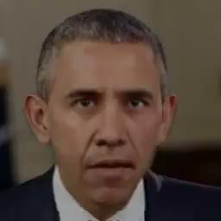
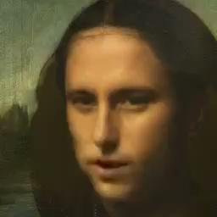

Last year result
Obama - Sad Monalisa - Sad Mark - Sad

Slide 4
What do we need to improve from last year’s work ?
Lip synchronisation => Wav2Lip(removing teeth) produces blurry mouth region
Emotion Generation => currently cannot generate emotion well, distorts faces
Head movement / Pose => No head movement at all
Resolution => DeepFaceLab used but it can be used only with the single image whereas Deep-fake requires multiple face images to train the model

Slide 5
List of Existing methods(Related to Emotion)
EAMM: One-Shot Emotional Talking Face via Audio-Based Emotion-Aware Motion Model (the most recent paper,
MEAD: A Large-scale Audio-visual Dataset for Emotional Talking-face Generation
Speech Driven Talking Face Generation from a Single Image and an Emotion Condition
Emotion-Controllable Generalized Talking Face Generation => No Github
Realistic Talking Face Synthesis with Geometry-Aware Feature Transformation => No Github

Slide 6

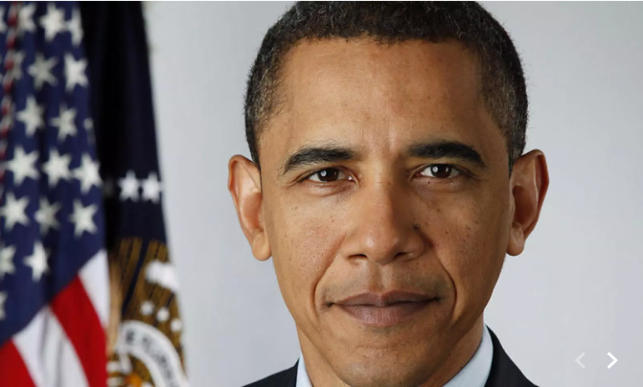
Original images

Slide 7

EAMM Result(Allan - Happy)

Slide 8
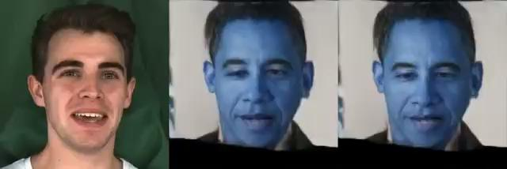
EAMM Result(Obama - Happy)

Slide 9
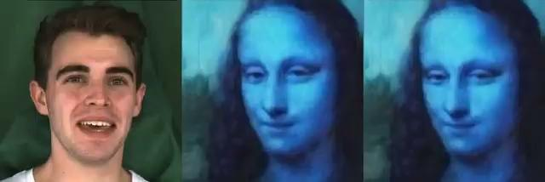
EAMM Result(Monalisa - Happy) → BGR

Slide 10
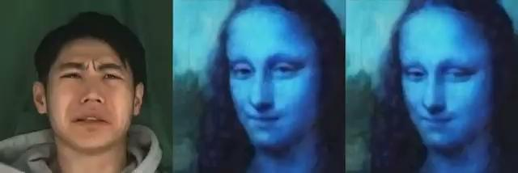
EAMM Result(Monalisa -Sad)

Slide 11
EAMM Results
Link for more videos
https://drive.google.com/drive/folders/117Mi9CM4rPYHftDAYF8yRLU_SKPPWzHZ?usp=share_link
Problems
RGB Channel wrongly set(can fix)
Face distorted
Emotion does not look accurate
Compared to our last year’s project, it does not look better

Slide 12
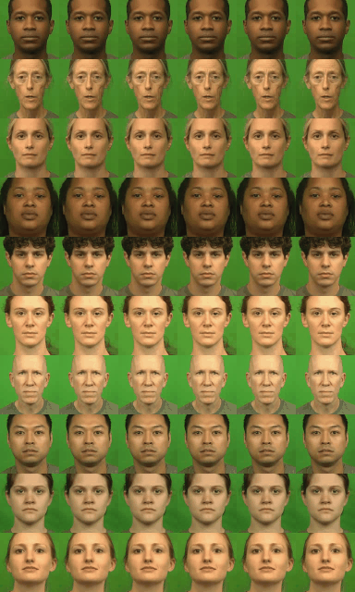
Speech Driven Talking Face Generation from a
Single Image and an Emotion Condition
Result
Each row shows 6 videos created using the same image and speech
but with different emotion input. Columns represent
anger, disgust, fear, happiness, neutral, and sadness, respectively.

Slide 13



Speech Driven Talking Face Generation from a Single Image and an Emotion Condition Result
Allan - Happy Allan - Neutral Allan - Sad

Slide 14



Speech Driven Talking Face Generation from a Single Image and an Emotion Condition Result
Allan - Angry Allan - Disgusted Allan - Fear

Slide 15
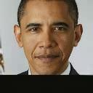


Speech Driven Talking Face Generation from a Single Image and an Emotion Condition Result
Obama - Happy Obama - Neutral Obama - Sad

Slide 16



Speech Driven Talking Face Generation from a Single Image and an Emotion Condition Result
Obama - Angry Obama - Disgusted Obama - Fear

Slide 17
Speech Driven Talking Face Generation from a Single Image and an Emotion Condition Result
Problems
Resolution is too low
Need preprocessing and it results green background of all generated videos.
In Face distortion, this is better than Ours and EAMM.

Slide 18
List of Existing methods(Pose)
Pose-Controllable Talking Face Generation by Implicitly Modularized Audio-Visual Representation (PC-AVS)
Make-It-Talk???
Result : https://drive.google.com/drive/folders/1NzI_u3XPncQiCYrtEJ9CAWGJT8SK3ihY?usp=share_link

Slide 19

PC-AVS
Lip synchronisation is pretty good
Head movement seems pretty natural
Face looks a bit different from the original image (the images given in the github for demo was fine but running with our photos seemed a bit different even though preprocessing was done)

Slide 20
Future work plan
Change StyleGan => ExprGAN which is designed for facial expression editing of image
=> StyleRig, technique used for 3D face reconstruction, in the StyleGan-based editing process
SPT-Wav2Lip Improvement => Train with different dataset, higher resolution
PC-AVS Pose implementation+ emotion generator
Evaluation

